Slide 1



WiFi MEDIA ADVERTISING PACK
Notes:
TF notes:
Designer - Make this into a header slide
Writer: Can we change the title? Maybe to something like “Media Advertising on the WiFi network pitch pack”? Or just “WiFi Media Advertising Pitch Pack” Or something similar if that’s too much of a mouthful.. I’m open to suggestions. The title should reflect that these are media advertising opps on the WiFi landing pages…

Slide 2

Here’s the deal
We’re the Virgin division dedicated
to keeping Human 3.0 happy. In fact,
we can be the difference between liking
a brand and loving it.
How so? Because our exceptional WiFi provides advertising opportunities to a captive audience throughout the UK.
Targeting select groups of consumers and
professionals is a sure-fire way to promote your brand.
And what better way than with media advertising?
Notes:
TF notes:
- WRITER: Provide intro and Target copy towards a potential advertising brand as a target audience and their exposure on our WiFi landing pages. But also explain what Virgin WiFi is, and where we cover Wifi for media advertising: these locations are; Heathrow airport all terminals, selected business lounges, regional airports, a group of 2000 pubs across the UK, Street WiFi and Councils. Idea – Can emphasise how media can ‘disrupt’ their advertising strategy/plans! Use the messaging framework to do this.

Slide 3





£850m
WiFi annual
turnover
30,000+
APs deployed
Our numbers
20m+
Sessions
per month
4m
Unique users
per month
5,200+
Premium WiFi
locations across the UK
Notes:
TF Notes:
DESIGNER: The layout of this slide should be able to be leveraged from the About Us presentation. Please make sure the following changes have also been incorporated.
Change ‘Arqiva’ to Virgin WiFi
Remove the first annual turnover circle
2nd circle: Change from 5m to 6m
Remove all circles referring to ‘hotels’
Please change the ’58 business airline lounges’ box to ‘16 business lounges have media advertising available on our WiFi network’
Change ‘32 airports’ to ‘14’. But also add that Heathrow (all terminals) is part of the 14
Maybe you can change the title to indicate something along the lines of this is where media advertising is available across our network as I have only provided the numbers for media availability and not WiFi as a whole
WRITER: No actions at this stage

Slide 4
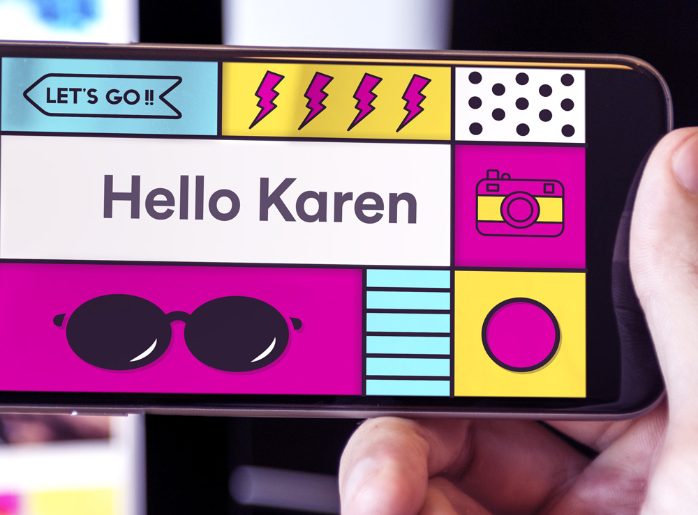
The perfect landing page for your brand
Our WiFi is available in premium locations to everyone from the most discerning traveller to, literally, the man on the street.
It offers a branded portal with bespoke options available to customise pages to your unique target audience.
And it collects valuable first party data.
Ours isn’t a world where users* grumble about poor coverage, or missed WhatsApp messages, or the email that didn’t come through.
With a service that’s fast, flexible and reliable, users can read, tag themselves, share pictures and write reviews until their hearts are content. The longer dwell time means a higher engagement rate.
All told, it’s an excellent all-round opportunity to consolidate your brand, maximise impressions and boost the click-through rate.
* Approximately 90% of our WiFi connections are now via mobile/tablet

Slide 5
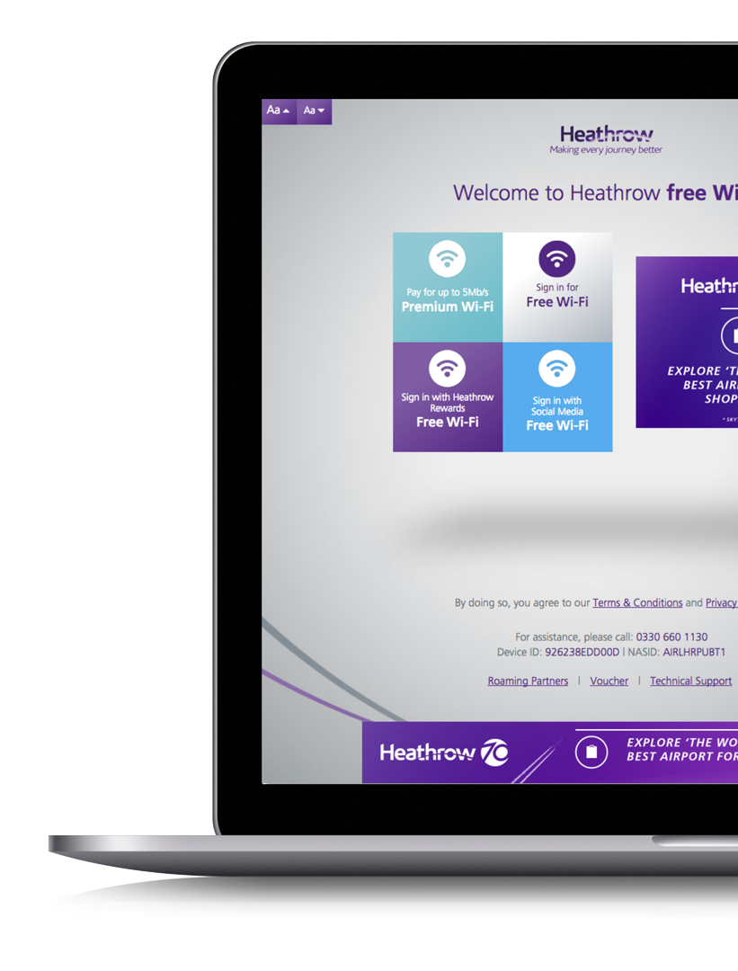






You’re spoilt for choice
Standard Media placements
MPU, Leaderboard, Mobile banner
(IAB formats)
Sponsorships
Take-over of the landing pages
which includes the above and background skins)
Video sponsorship campaigns
All of the above but with
a video incorporated
Programmatic ads
Specific demographic targeting
Bespoke advertising strategies
Named SSIDs, emails, etc
Our range of
bespoke solutions
includes:
Notes:
TF Notes: Edit as per the messaging framework, add punchy headline
TF notes:
- WRITER: Edit as per the messaging framework, add punchy headline. Refer to clients notes on objective.
- DESIGNER: Layout as appropriate in relevant slide style, add icons for laptop, tablet and mobile
RG notes:
- Objective: Now we’ve outlined who we are and where they can advertise, I want to outline what opportunities are available
Also need to specify that the ads would be across all devices: laptop, tablet and mobile

Slide 6
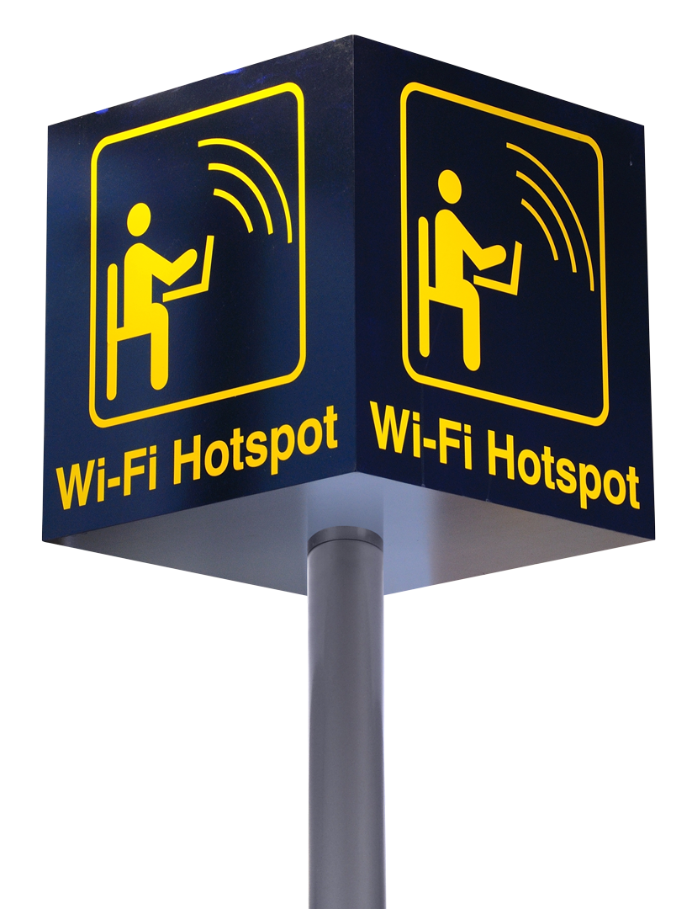
A world of opportunity
What do four Heathrow terminals, 14 regional airports, 16 business lounges and 2,000 pubs have in common?
They’re powered by high
quality WiFi service from
Virgin Media Business.
And that’s in addition to street
WiFi in some of the fanciest
parts of London, plus numerous council networks.
So whether you want to target globe-trotting business people, football fans watching the match in their local or consumers on the high street, you can take your pick.
When it comes to coverage for your brand, we’ve got it covered.

Slide 7


































Some of our patners include:
Notes:
TF notes:
Writer: Add a punchy headline
Designer: Group into retail, hospitality, public spaces and travel (as per previous slide – please also refer to the About Us presentation for the new layout)

Slide 8
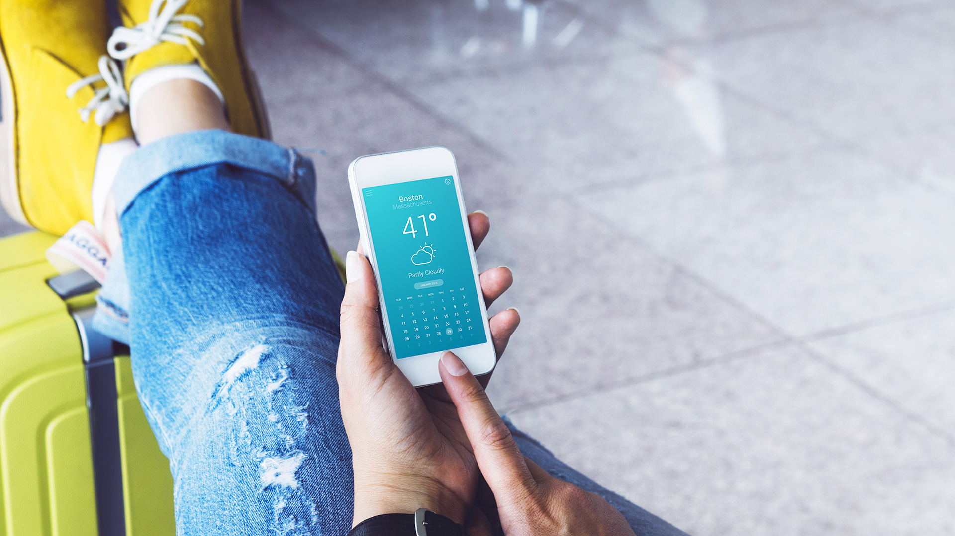
Travel: a truly
worldwide web
Besides broadening horizons, travel broadens scope for your brand to be noticed and engaged with.
After all, it used to be kiss and fly. Now
it’s more like check-in, log-in, FaceTime,
work a bit. And then fly.
So what unlocks all this visitor value?
The UK’s international airports know it’s all
about the WiFi travellers are using and the brands they are exposed to on their journey.
Make sure your brand isn’t missing out.

Slide 9
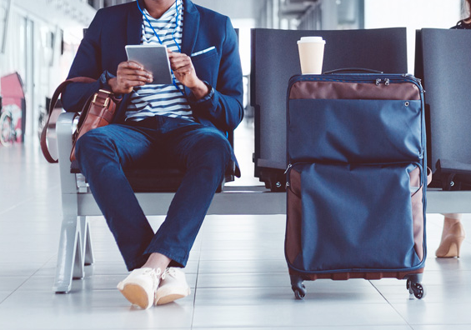
Flying high at Heathrow
If, like Heathrow, you want to make ‘every journey better’, the answer is probably quite important.
These are the facts of the case.
We installed a significant upgrade at Heathrow. It’s faster. More resilient. And intuitive.
Usage has grown by 50 per cent.
The 2,200 access points now connect approximately 1.1m devices a month.
Every journey that involves WiFi is now, indeed, a good deal better.
And with WiFi this good, brand
visibility and engagement is soaring.
Is higher quality WiFi really used by more people more often?
Notes:
TF notes:
Writer: Make this a Heathrow section – review all Heathrow slides together – edit content as appropriate in line with MF – add in punchy section header. Note Heathrow is the biggest and best part of our inventory so should come first in the ‘Travel’ section and really be the hero.

Slide 10



The
Average WiFi dwell time of
The
Average of
busiest
43mins
biggest
3.7m
airport in the world, which means it will have the highest number of WiFi users in one place at a time!
per user
And most exciting site in the UK
sessions each month
Heathrow: The stats
Around
Approx.
60,000
Average of
1.1m
14m
people can be connected at any given point in time. There are no real peak times – every hour is rush hour in an airport
unique users each month
ad impressions across all terminals in one month
Notes:
TF Notes:
- WRITER: Combine this with the previous slide.

Slide 11
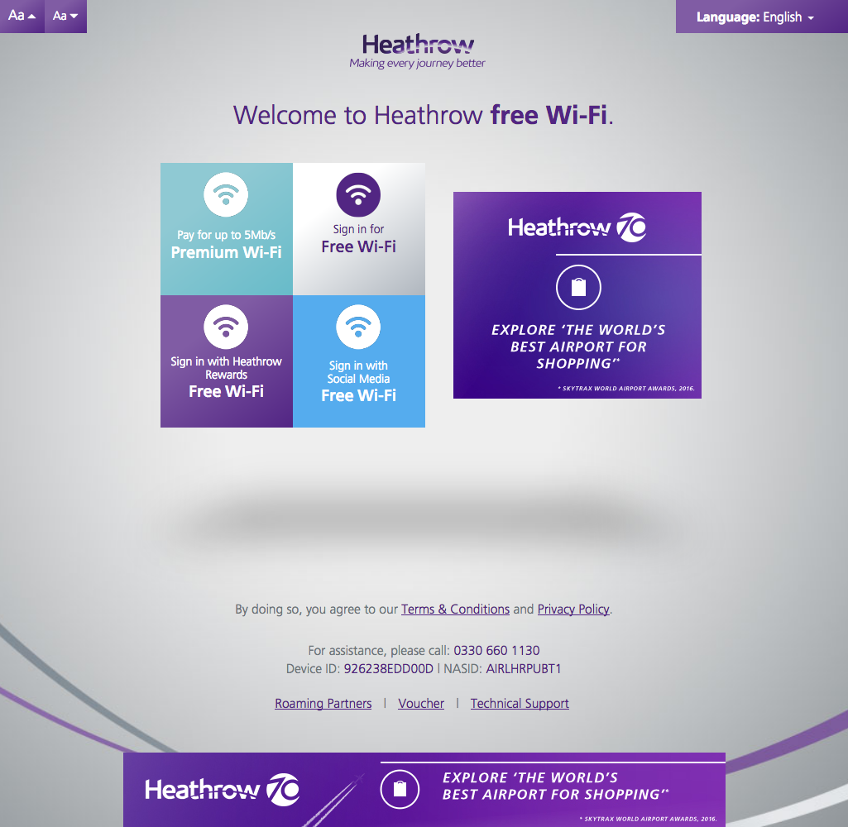

Heathrow user journey
The welcome page
MPU
Leaderboard
Notes:
TF Notes:
WRITER: Add punchy headline like ‘where we can get you noticed’ and come up with something better than ’The Welcome page’
DESIGNER: Create page design and place arrows as to where the media placements are – MPU & Leaderboard

Slide 12
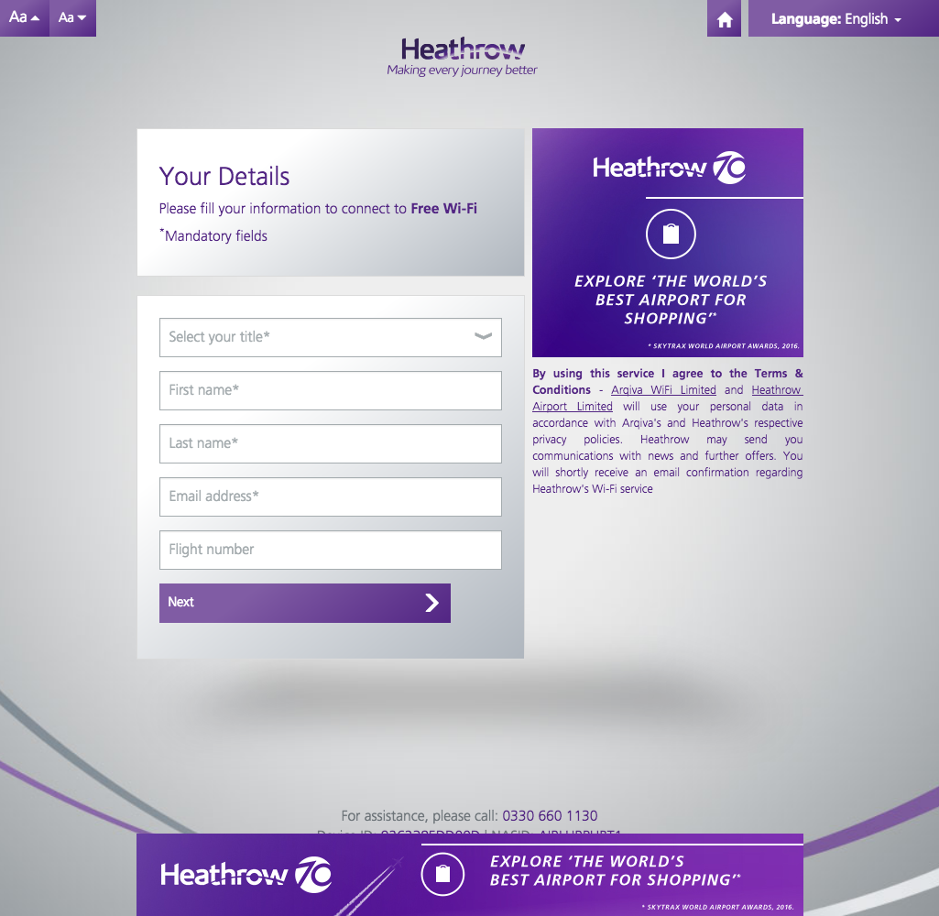
Heathrow user journey
The registration page
MPU
Leaderboard
Notes:
TF notes:
DESIGNER: Create page design

Slide 13
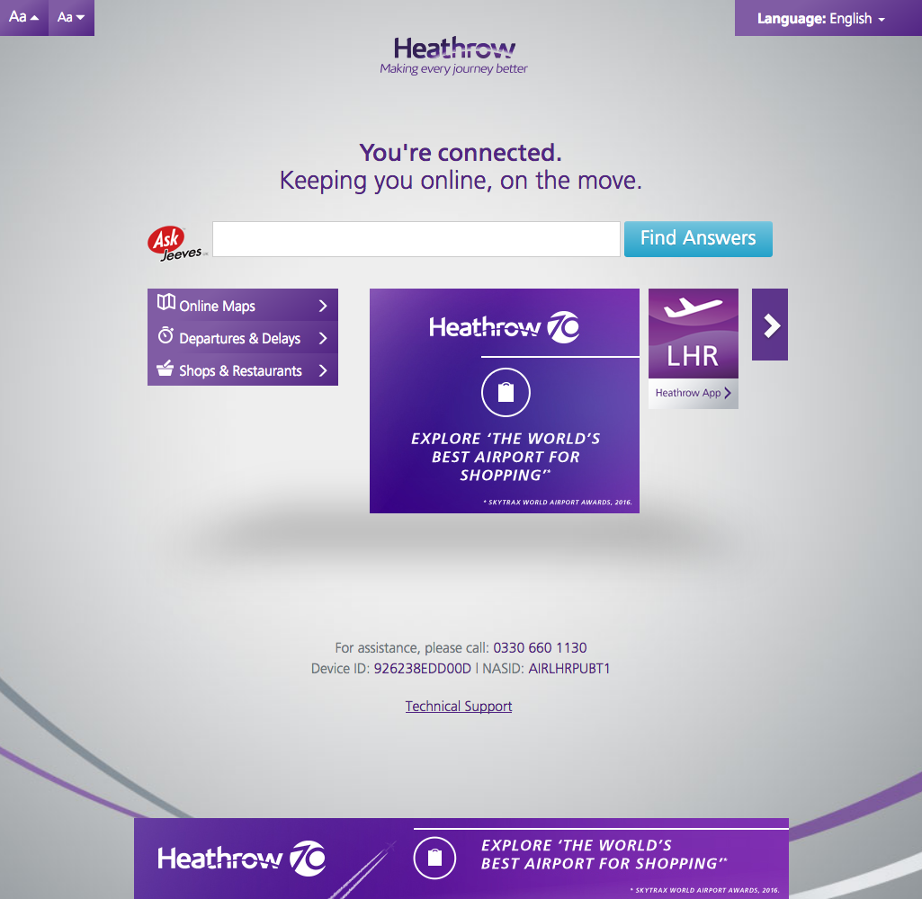
Heathrow user journey
The online page
MPU
Leaderboard
Notes:
TF Notes:
DESIGNER: Create page design

Slide 14
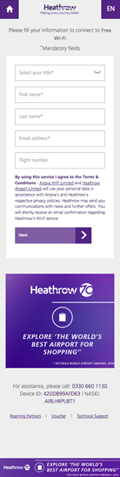
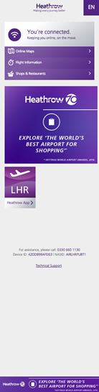
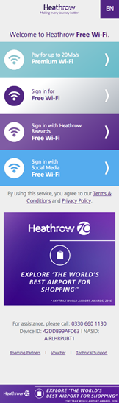

Heathrow user journey
Mobile placements
MPUs
Mobile banners
Notes:
TF Notes:
DESIGNER: Create page design – show Mobile screenshots examples

Slide 15
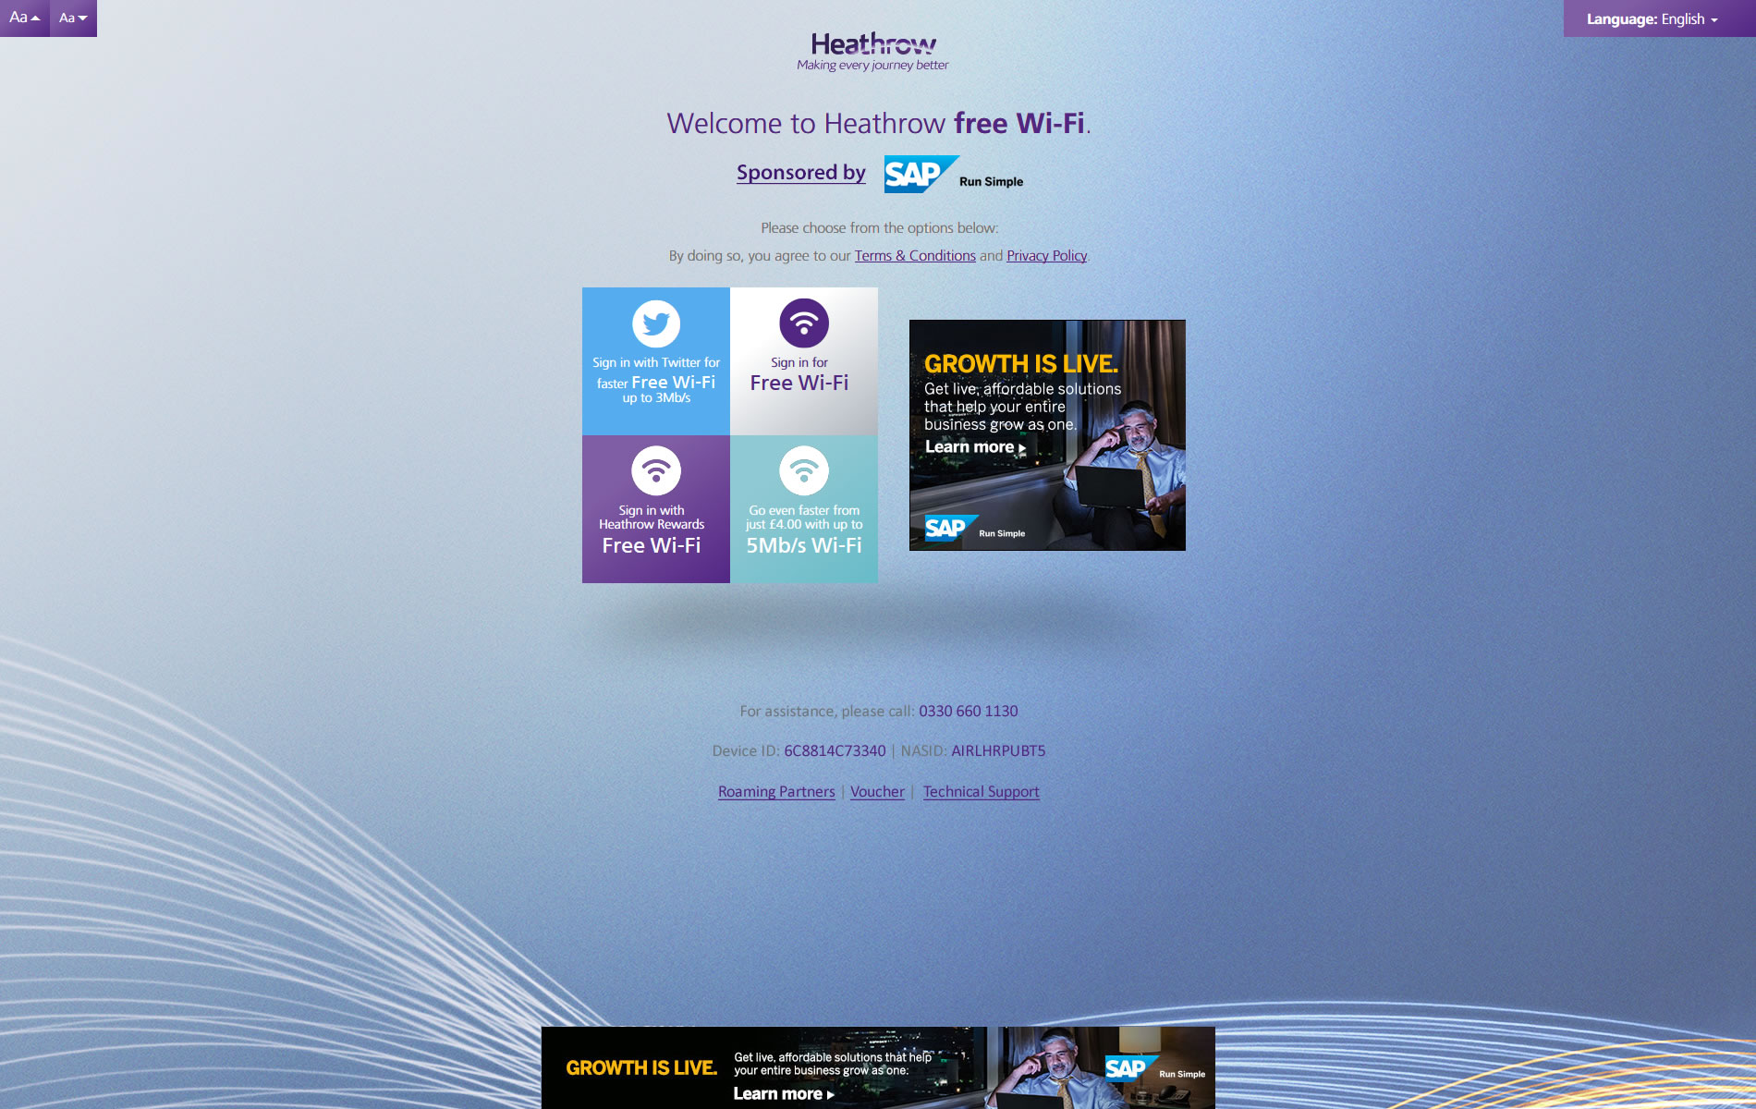
Heathrow sponsorship helps brands take off
Heathrow user journey
Sponsorship
MPU
Background skin
Leaderboard
Notes:
TF notes:
- Writer: Add punchy headline about sponsorship

Slide 16

Lounges are the business
Get results while customers get comfy
Business lounges primarily accommodate a business audience at CEO/Director level.
They see an average of 44,000 sessions per month with two page user journeys.
While user numbers are smaller, user influence is much greater. A case of quality over quantity.

Slide 17
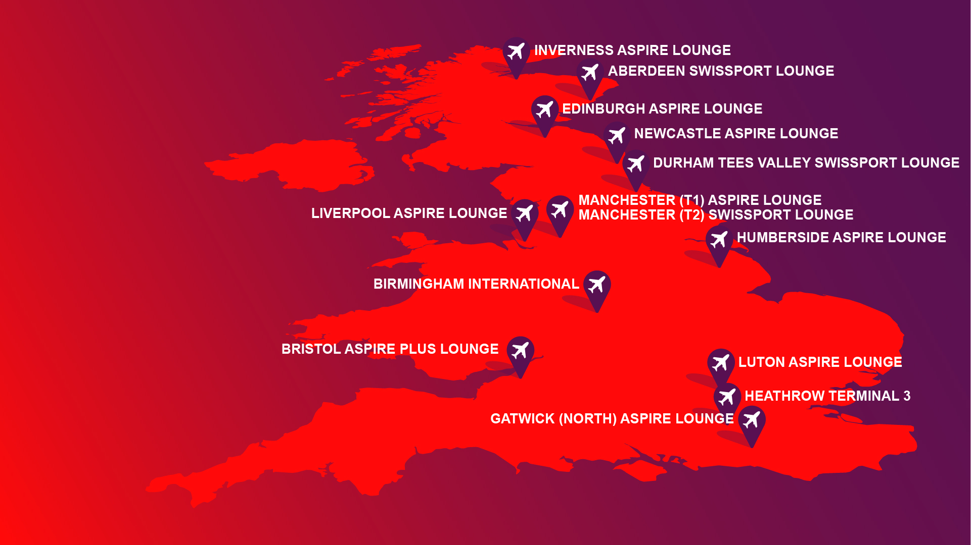
Lounging from Inverness to Bristol
Notes:
TF notes:
Writer: Add punchy headline and place nice image of a lounge behind.
Designer: Design up this slide, add image or icons to make it not look so information heavy.

Slide 18
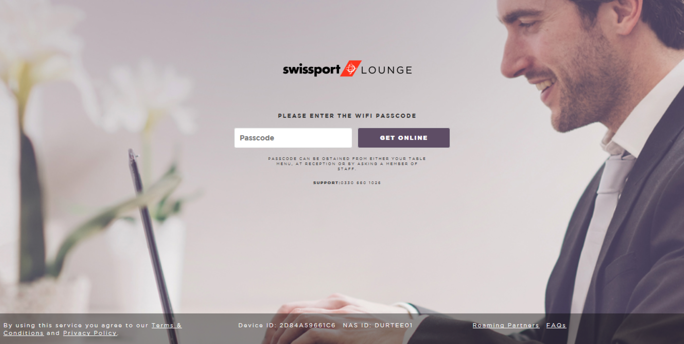
Business Lounges user journey
The registration page
Notes:
TF notes:
WRITER: Add punchy headline like ‘see how it works’ show screenshot image and include link to actual site as below.
Designer: This slide needs to show the user journey for the business lounges and should be included straight after the slides for business lounges. Please see if you can access the link below and screenshot it…
RG Notes: Jenny: Currently no media placements on here, but bespoke options available

Slide 19
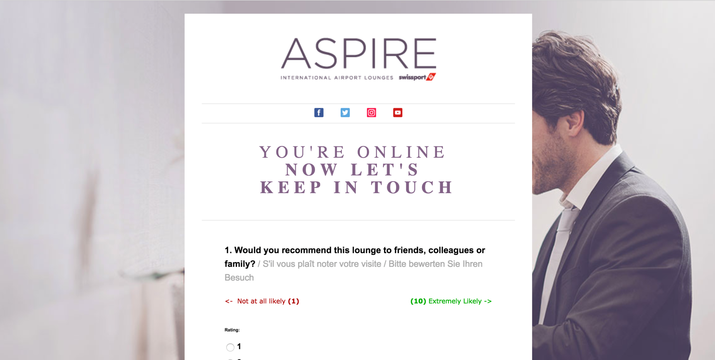
Business Lounges user journey
The online page
Notes:
TF notes:
- Designer: Please design up the page

Slide 20
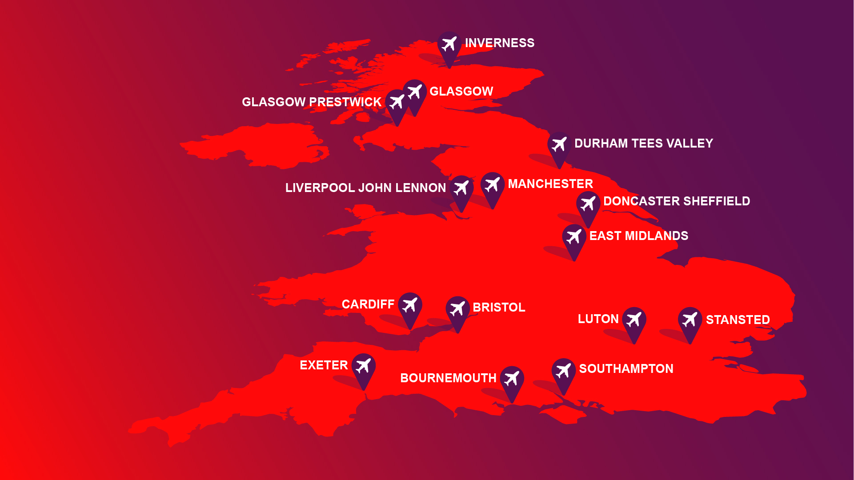
We’ve got the regions covered too
Notes:
TF notes:
WRITER - Add punchy headline and edit sub header using messaging framework
DESIGNER – Please design this up and maybe add icons if they can be used to simplify

Slide 21

Regional airports:
The stats
A monthly breakdown of...
Over
420,000
4.5m
1.2m
sessions
average unique users
impressions
Notes:
TF notes: Add punchy header and edit copy using messaging framework. Please also add in copy to make this sound more inviting!
Sessions, uniques and impressions: Please make this as a consistent design format across all locations. All stats have been included.

Slide 22
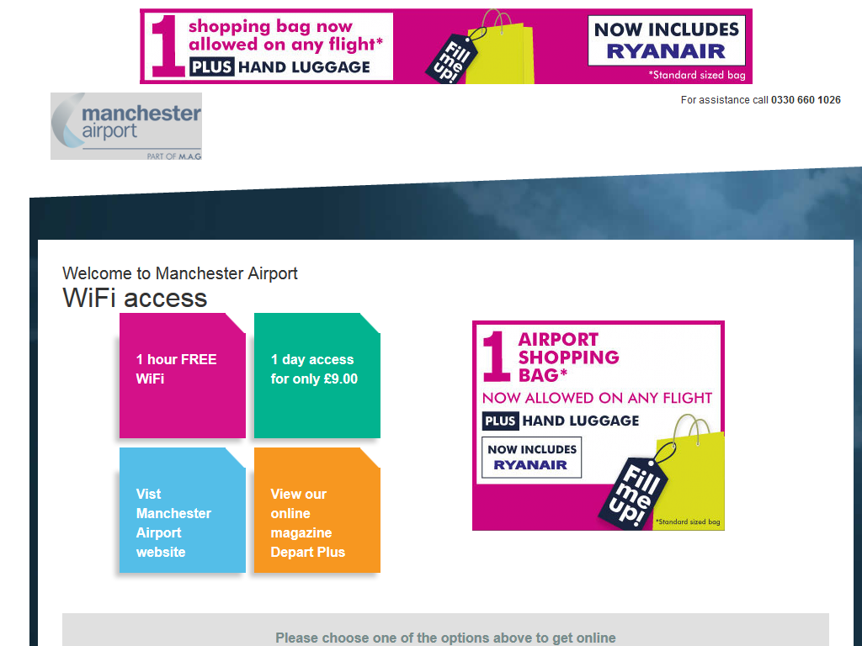
Manchester Airport user journey
The welcome page
Leaderboard
MPU
Notes:
TF notes:
WRITER: Add punchy header and then the rest should be done in design.
DESIGNER: Create slide layout
- Are you able to outline somewhere that each airport has a different look and feel? This is just an example of one…

Slide 23
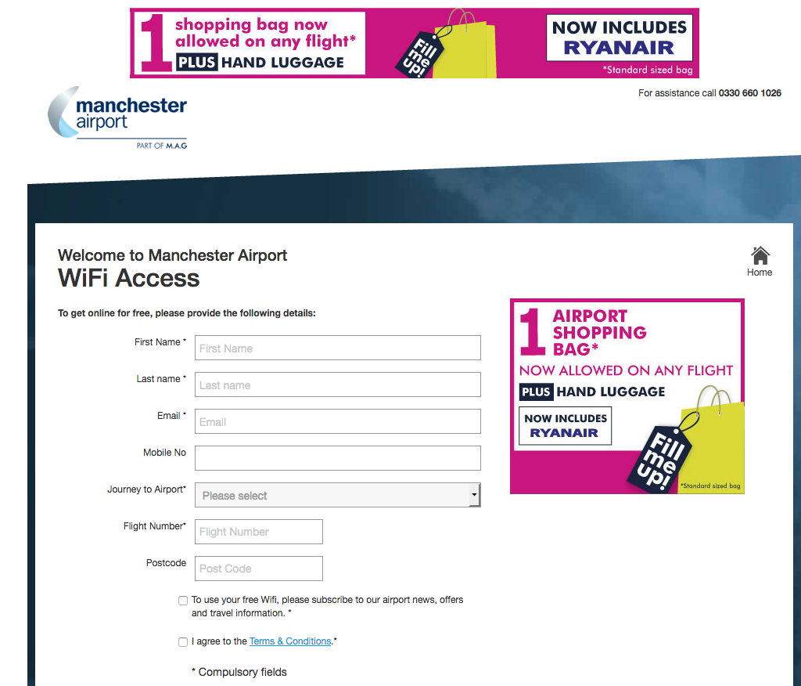
Manchester Airport user journey
The registration page
Leaderboard
MPU
Notes:
TF notes:
DESIGNER: Create page design

Slide 24
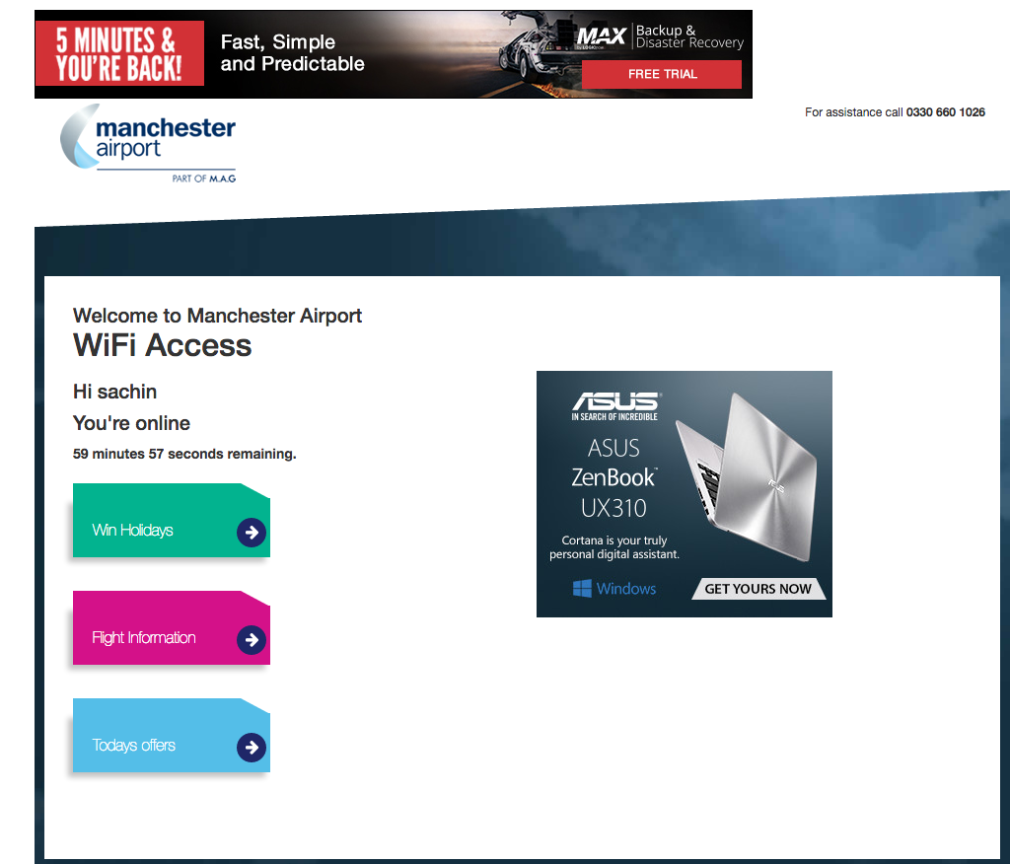
Manchester Airport user journey
The online page
Leaderboard
MPU
Notes:
TF notes:
DESIGNER: Create page design

Slide 25
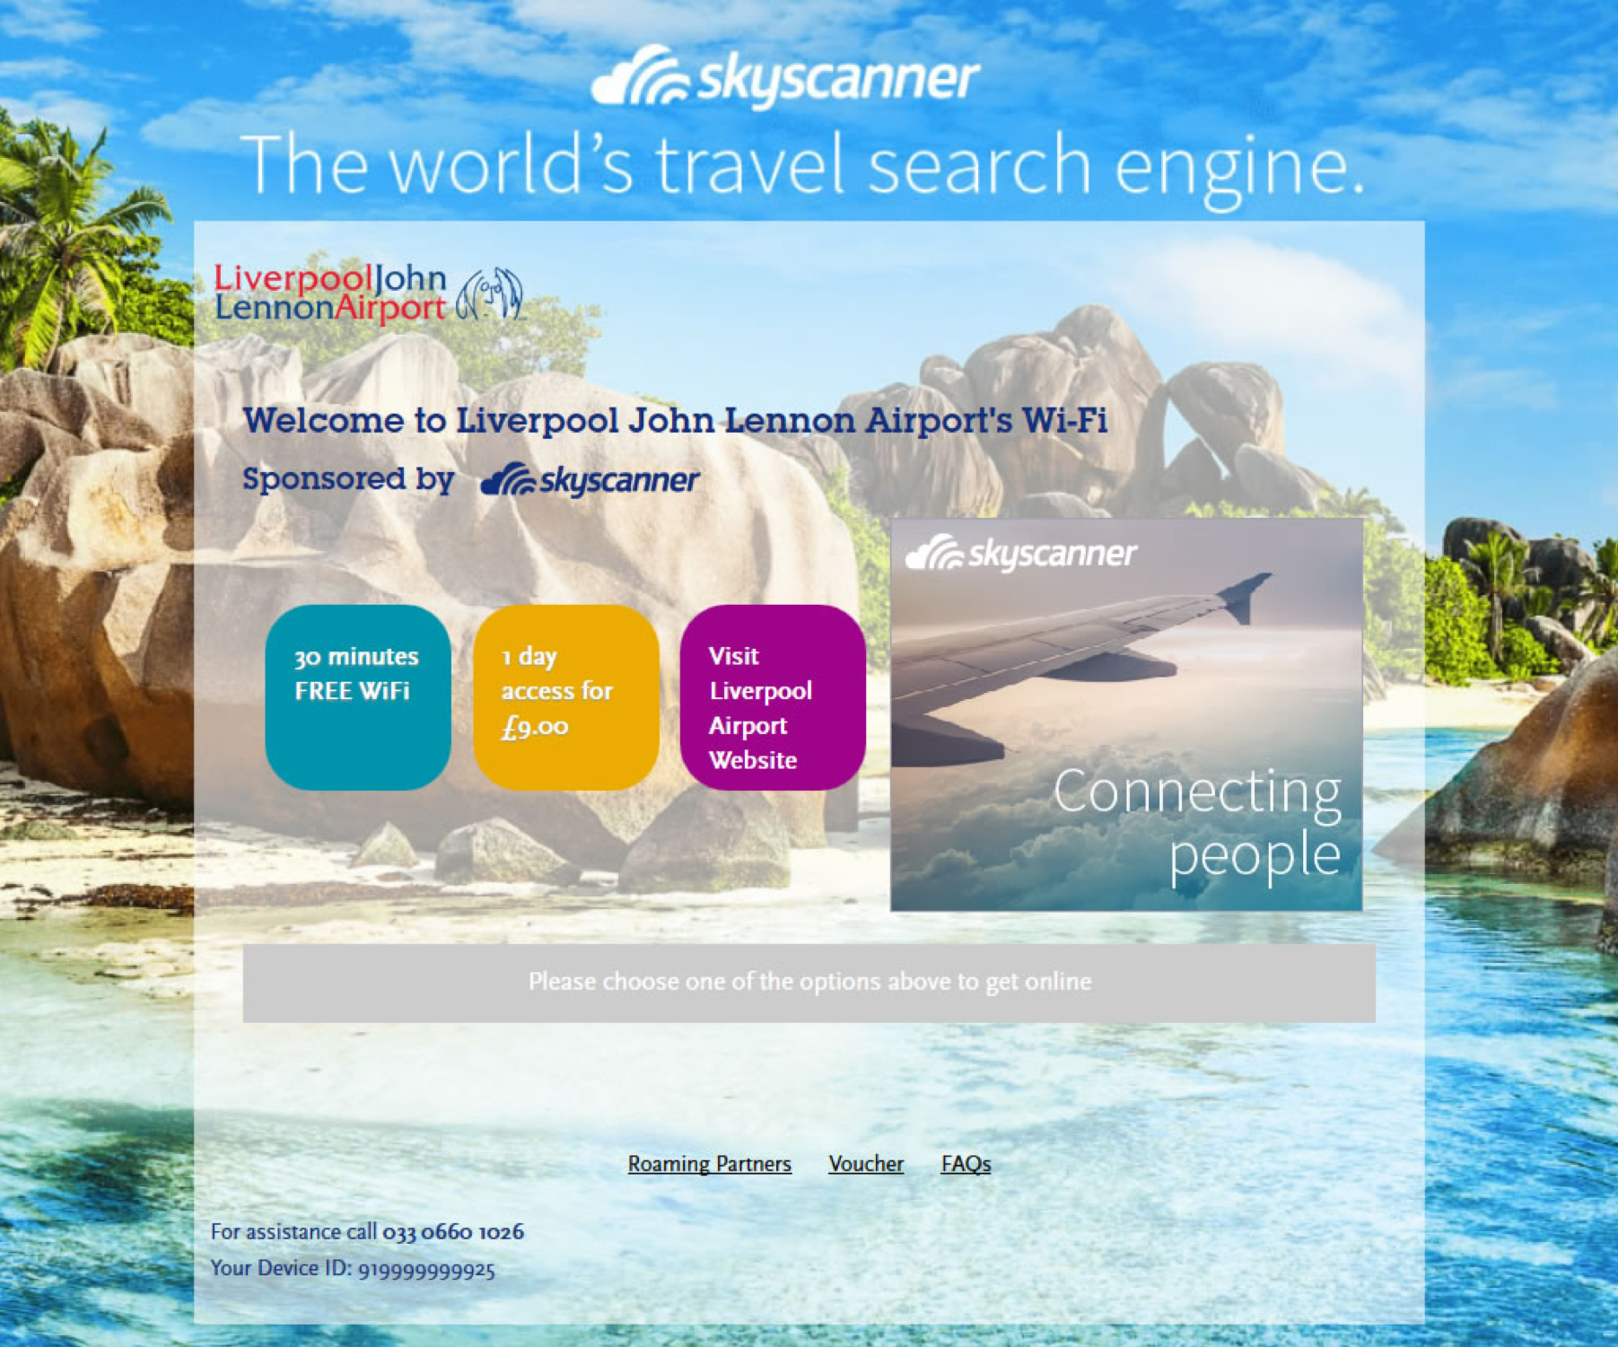
Sponsorship
Regional sponsorship means the sky’s the limit
MPU
Background skin
Notes:
TF notes:
Writer: Add punchy headline
Designer: Design slide highlighting the media opportunities. Note – the screenshot will need to be updated as it currently shows Arqiva.

Slide 26

Hospitality:
an opportunity to get your teeth into
Nowadays punters prefer to check the latest news, sport and social updates on their handheld devices, and demand fast, reliable WiFi to do so.
Thanks to WiFi media advertising, the savviest establishments are raising a glass to WiFi that pays back.
The time-honoured tradition of nursing
a cup of coffee is here to stay, even if a simultaneous flick through the papers
is fast becoming a thing of the past.
Notes:
TF Notes:
WRITER - Punchy headline and then leverage content from the messaging framework.

Slide 27

Enterprise Inns:
The stats
Approx. 2,000 pubs across the UK
A monthly breakdown of:
1.3m
sessions
150,000
Average unique users
3m
Average impressions
WiFi advertising is an ideal way to reach a pub audience who are socialising and watching sports. There’s even an option for users to watch a specially-tailored video before they gain access to the internet.
Notes:
TF notes:
WRITER: Add punchy headline and re-write using the messaging framework
DESIGNER: Create pay layout and add icons
RG notes: See attached PP presentation for more info (created by Ad2one in PDF format so cannot copy and paste)
RG: Did you review the presentation I had attached? and can you add anything else in to make this look like more of an attractive sales opp? – You could add in the mobile placements? Because of the length of this presentation already (long!) we would recommend keeping the bullet points up front and then just showing the user journey.

Slide 28
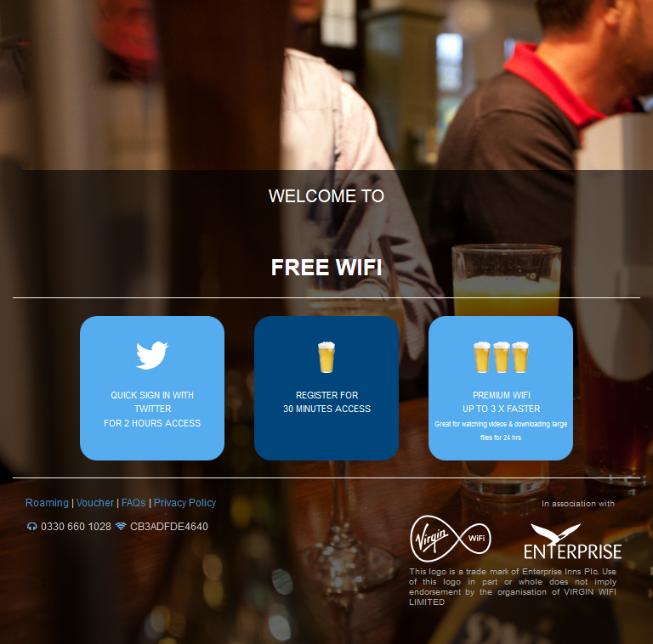
Enterprise Inns user journey
The welcome page
Notes:
TF notes:
WRITER: Add punchy headline
DESIGNER: Create page layout

Slide 29
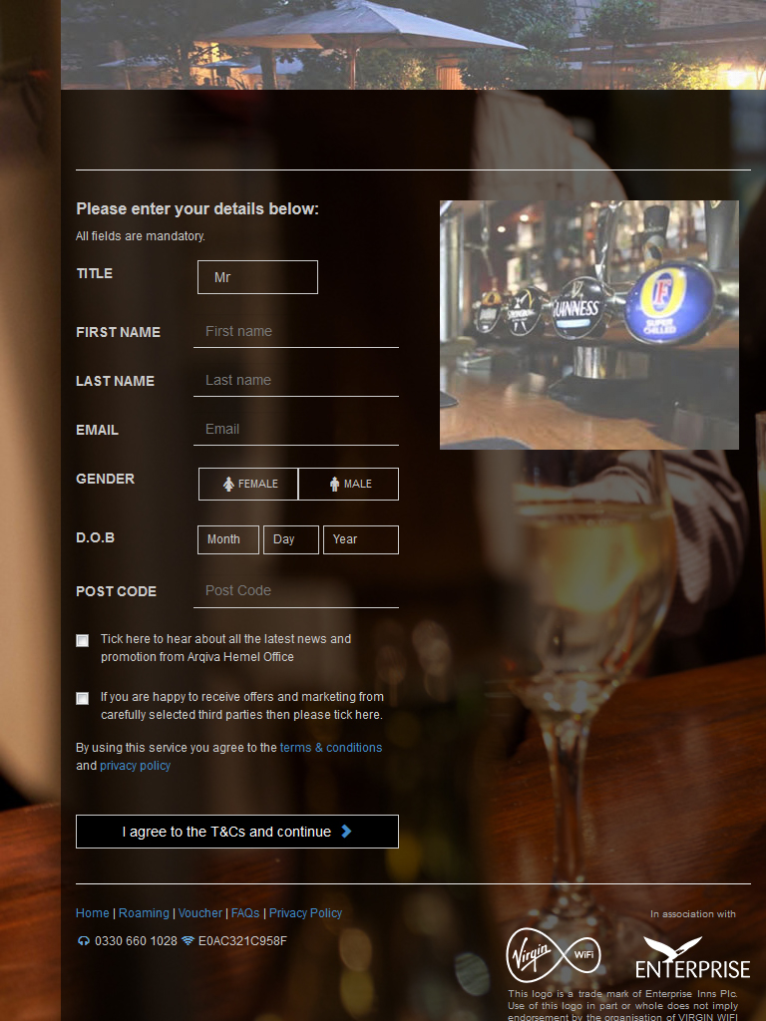
Enterprise Inns user journey
Leaderboard
The registration page
MPU
Notes:
TF notes:
DESIGNER: Create page layout

Slide 30
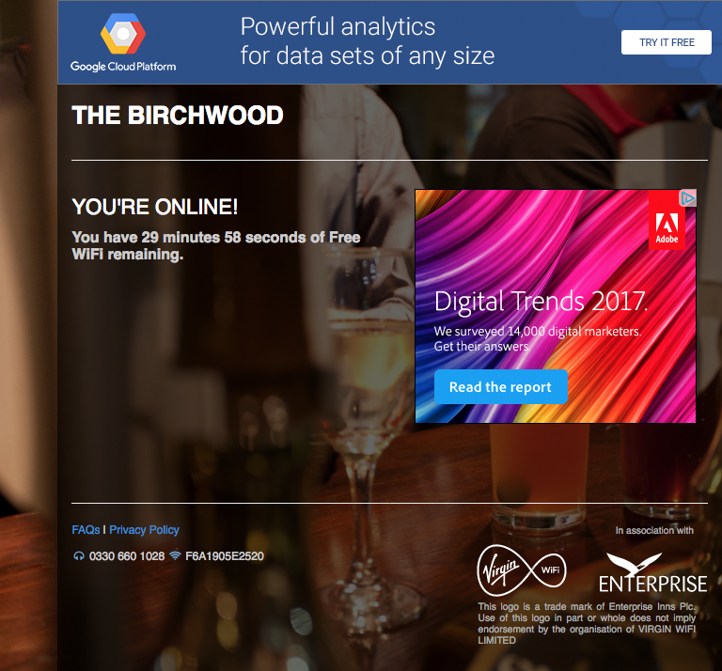
Enterprise Inns user journey
The online page
Leaderboard
MPU
Notes:
TF notes:
DESIGNER: Create page layout

Slide 31

Places and spaces:
It pays to go public
Q
If publicly available WiFi is fast, available – and usually free – is it possible to make money from it?
A
Of course!
From connected high streets to council spaces, public access has been transformed.
Just ask no less than 16 councils, including Manchester, Colchester and Southampton.

Slide 32


Available at approx.
Approx.
Street WiFi:
The stats
2,000
£130
300,000
access points
across London
For one year. Many residents use this option if they are near a kiosk
impressions per month
Used by residents and tourists alike
High footfall
SSID take-over at an extra cost
Notes:
TF notes:
WRITER: Add punchy headline and edit using the messaging framework
DESIGNER: Create page layout

Slide 33
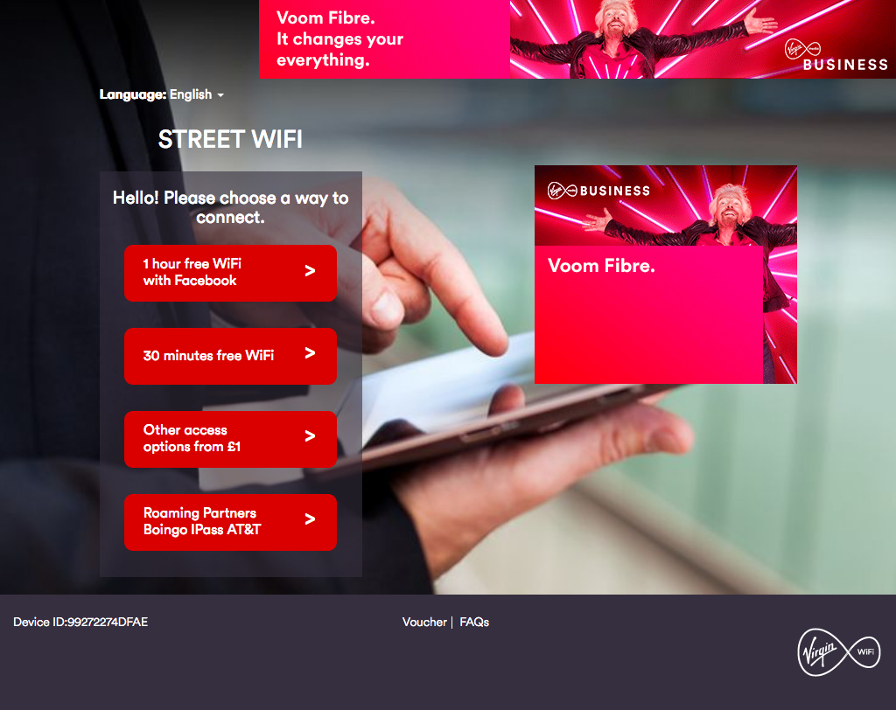
Street WiFi user journey
The welcome page
Leaderboard
MPU
Notes:
TF notes:
WRITER: Add punchy headline and articulate that the MPU & leaderboard placement will be available for advertising very shortly.
DESIGNER: Create page layout

Slide 34
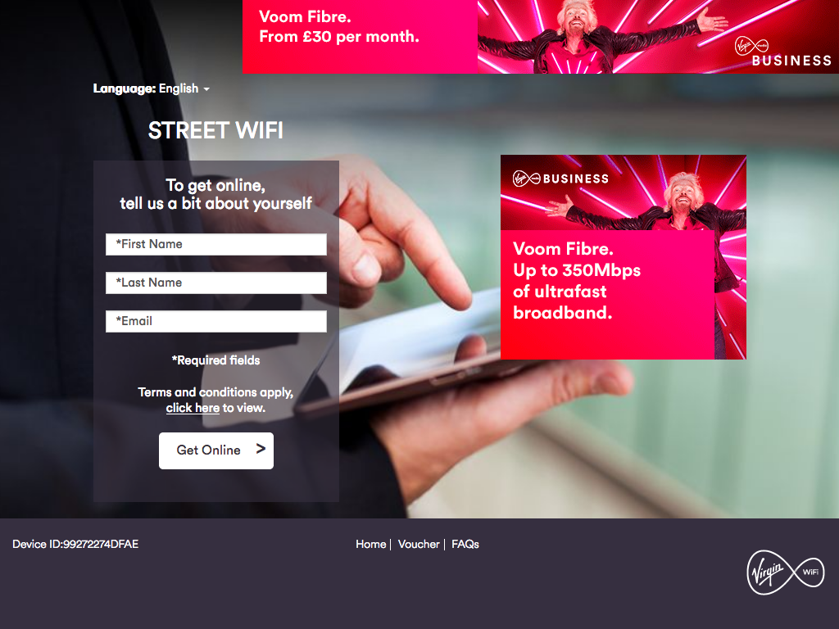
Street WiFi user journey
The registration page
Leaderboard
MPU
Notes:
TF notes:
DESIGNER: Create page layout

Slide 35
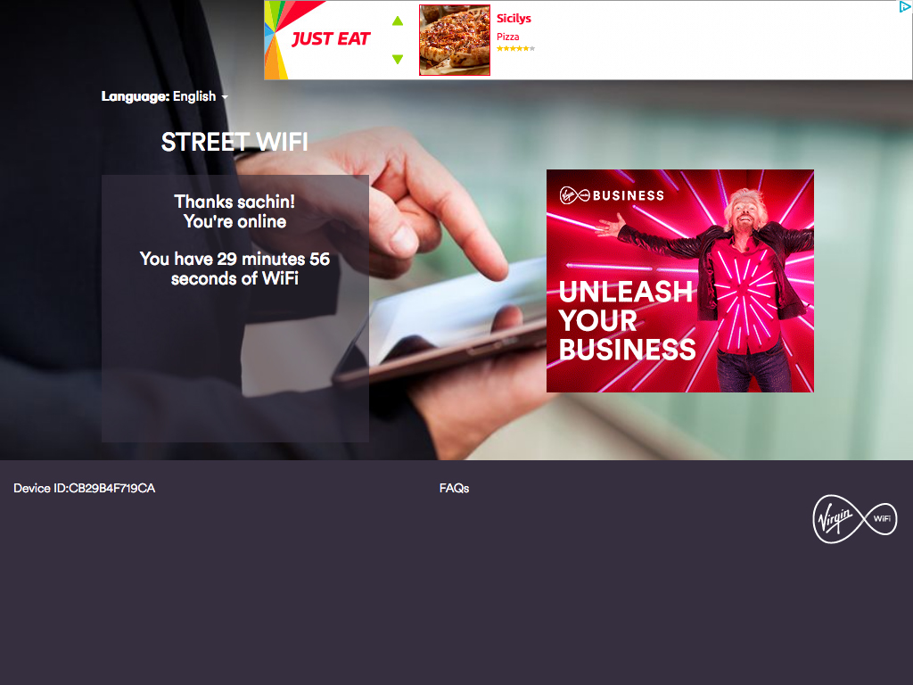
Street WiFi user journey
The online page
Leaderboard
MPU
Notes:
TF notes:
DESIGNER: Create page layout

Slide 36
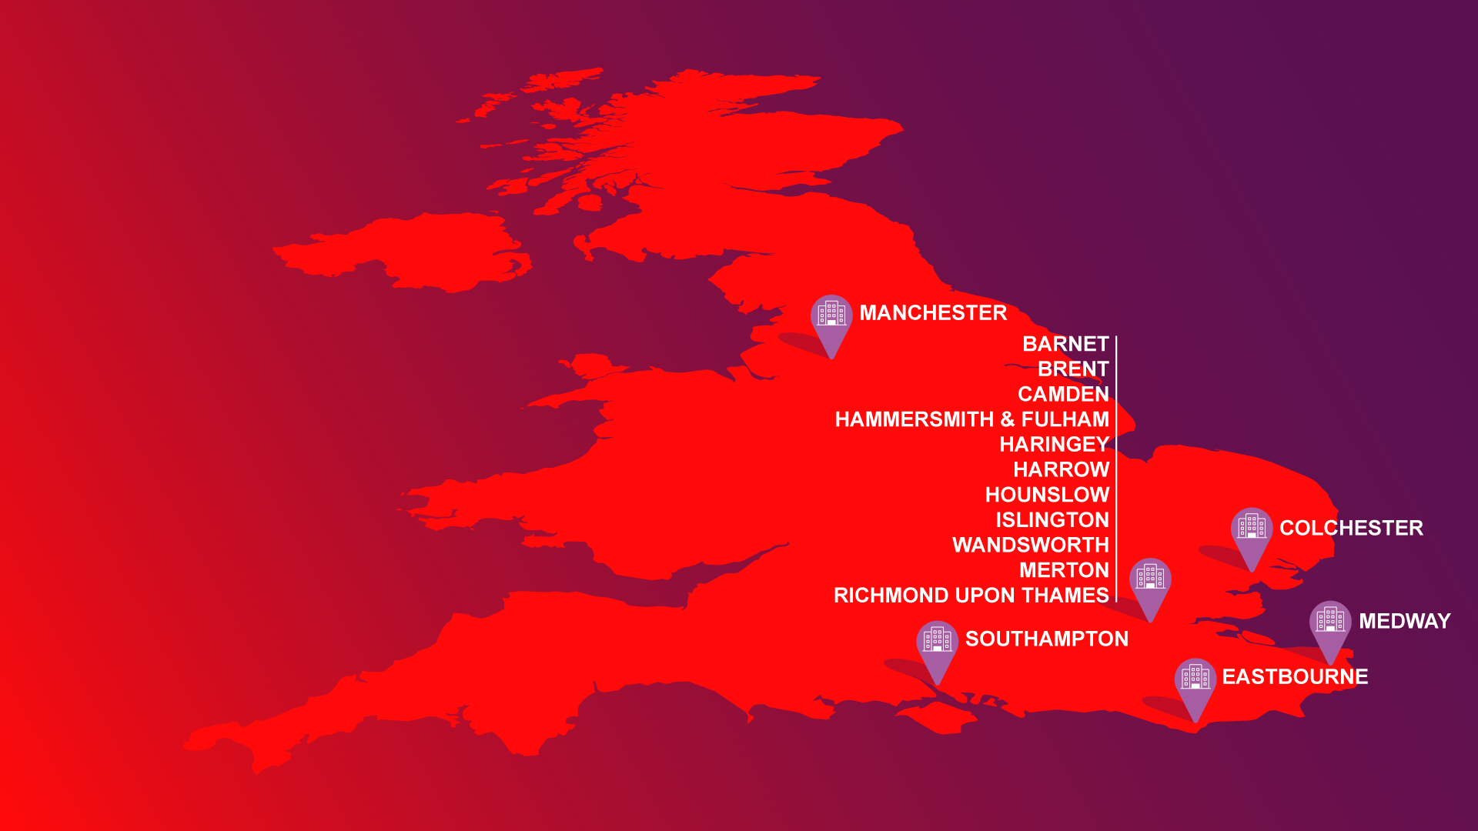
Whether North
or South, you don’t
have to look
far for a council
using and benefiting
from our WiFi
Notes:
TF notes:
WRITER: Add punchy headline and update copy based on messaging framework
DESIGNER: Create page layout

Slide 37

A monthly breakdown of...
Over
Councils:
The stats
60,000
average
sessions
28,000
unique
users
800,000
average impressions
Notes:
TF notes:
WRITER: Add punchy headline and update copy based on messaging framework
DESIGNER: Create page layout

Slide 38
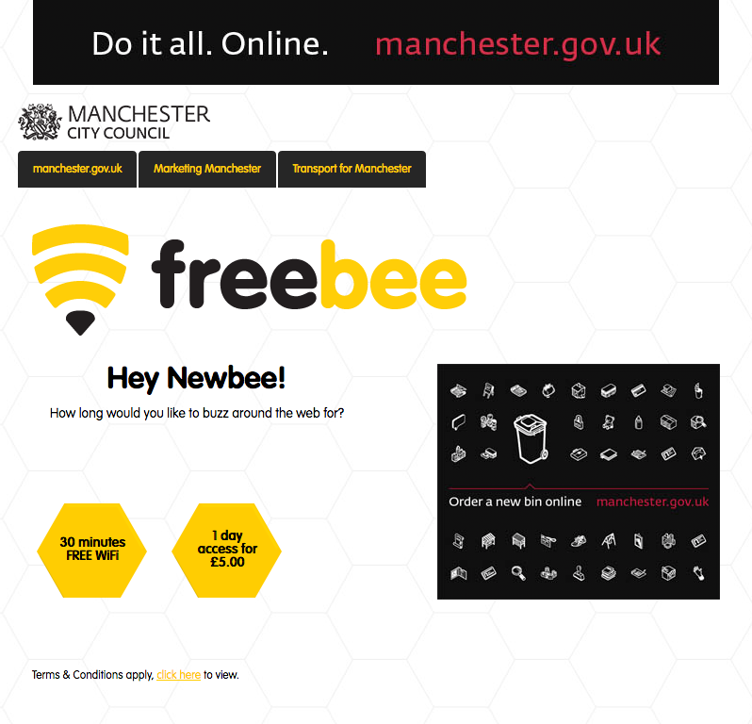
Council WiFi user journey
The welcome page
Leaderboard
MPU
Notes:
TF notes:
WRITER: Add punchy headline and update copy as per the messaging framework
DESIGNER: Create page layout – highlighting the advertising placements

Slide 39
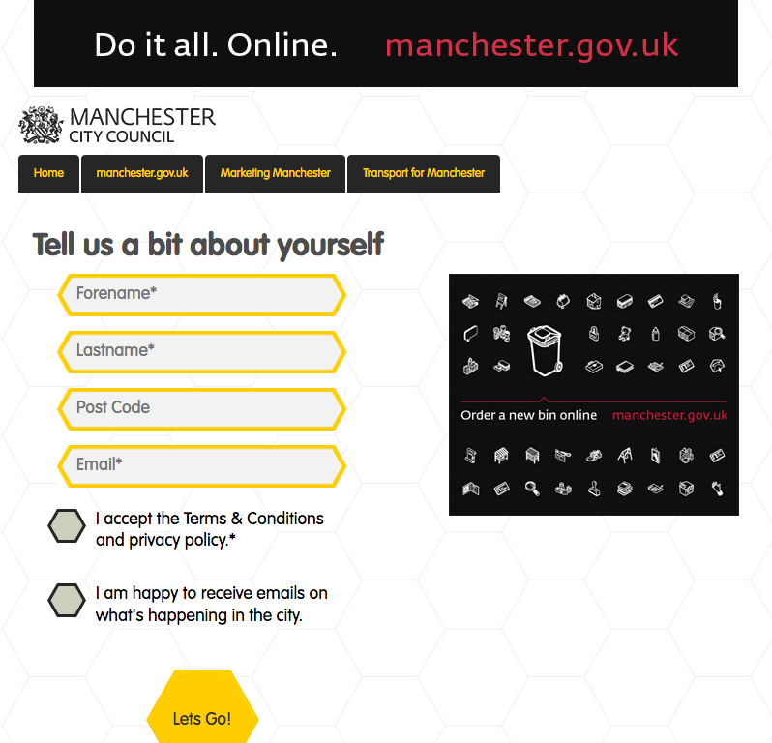
Council WiFi user journey
The registration page
Leaderboard
MPU
Notes:
TF notes:
DESIGNER: Create page layout – highlighting the MPU advertising placement

Slide 40
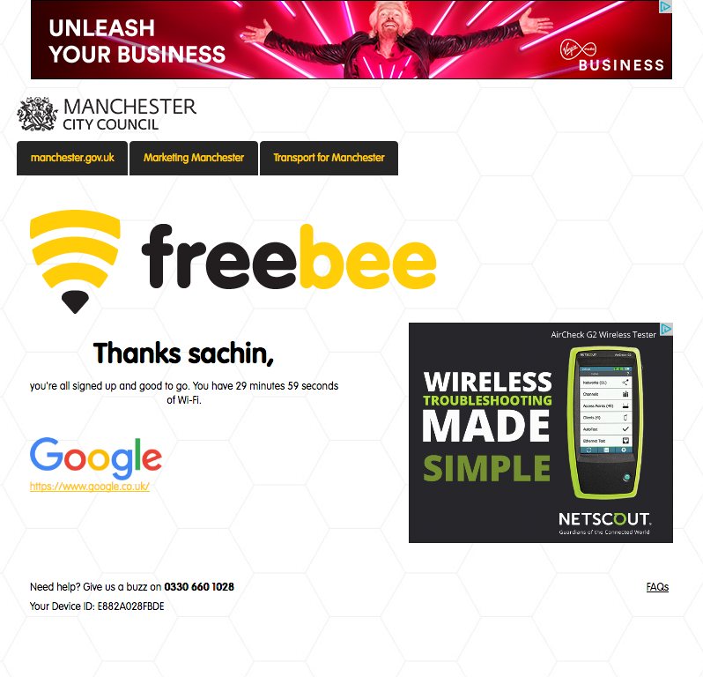
Council WiFi user journey
The online page
Leaderboard
MPU
Notes:
TF notes:
DESIGNER: Create page layout – highlighting the advertising placement/s

Slide 41
Get in touch
To find out more about WiFi advertising,
call Ria Ghai on 07855 123069
or drop us a line to wifi@virginmedia.co.uk

